Slide 1


Slide 2
Chapter 1
Introduction and Conceptual Modeling

Slide 3
Types of Databases and Database Applications
Numeric and Textual Databases
Multimedia Databases
Geographic Information Systems (GIS)
Data Warehouses
Real-time and Active Databases

Slide 4
Basic Definitions
Data: Known facts that can be recorded and have an implicit meaning.
Database: A collection of related data.
Database Management System (DBMS): A software package/ system to facilitate the creation and maintenance of a computerized database.
Database System: The DBMS software together with the data itself. Sometimes, the applications are also included.

Slide 5
Typical DBMS Functionality
Define a database : in terms of data types, structures and constraints
Construct or Load the Database on a secondary storage medium
Manipulating the database : querying, generating reports, insertions, deletions and modifications to its content
Concurrent Processing and Sharing by a set of users and programs – yet, keeping all data valid and consistent

Slide 6
Typical DBMS Functionality
Other features:
  Protection or Security measures to prevent unauthorized access
  Internal actions on data
  Presentation and Visualization of data

Slide 7
Example of a Database
(with a Conceptual Data Model)
Part of a UNIVERSITY environment.
  STUDENTs
  COURSEs
  SECTIONs
  DEPARTMENTs
  INSTRUCTORs

Slide 8
Example of a Database
(with a Conceptual Data Model)
Some relationships:
  SECTIONs are of specific COURSEs
  STUDENTs take SECTIONs
  COURSEs have prerequisite COURSEs
  INSTRUCTORs teach SECTIONs
  COURSEs are offered by DEPARTMENTs
  STUDENTs major in DEPARTMENTs
Note: The above could be expressed in the ENTITY-RELATIONSHIP data model.

Slide 9
Main Characteristics of the Database Approach
Self-describing nature of a database system: A DBMS catalog stores the description of the database. The description is called meta-data. This allows the DBMS software to work with different databases.
Insulation between programs and data: Called program-data independence. Allows changing data storage structures and operations without having to change the DBMS access programs.

Slide 10
Main Characteristics of the Database Approach
Data Abstraction: A data model is used to hide storage details and present the users with a conceptual view of the database.
Support of multiple views of the data: Each user may see a different view of the database, which describes only the data of interest to that user.

Slide 11
Main Characteristics of the Database Approach
Sharing of data and multiuser transaction processing : allowing a set of concurrent users to retrieve and to update the database.
  Concurrency control within the DBMS guarantees that each transaction is correctly executed or completely aborted.

Slide 12
Database Users
Users may be divided into those who actually use and control the content (called “Actors on the Scene”) and those who enable the database to be developed and the DBMS software to be designed and implemented (called “Workers Behind the Scene”).

Slide 13
Database Users
(Actors on the scene)
  Database administrators: responsible for authorizing access to the database, for co-ordinating and monitoring its use, acquiring software, and hardware resources, controlling its use and monitoring efficiency of operations.
  Database Designers: responsible to define the content, the structure, the constraints, and functions or transactions against the database. They must communicate with the end-users and understand their needs.
  End-users: they use the data for queries, reports and some of them actually update the database content.

Slide 14
Categories of End-users
Casual : access database occasionally when needed
Parametric : they make up a large section of the end-user population. They use previously well-defined functions in the database. Examples are bank-tellers who do this activity for an entire shift of operations.

Slide 15
Categories of End-users
Sophisticated : these include business analysts, scientists, engineers, etc. who are familiar with the system capabilities.
Stand-alone : mostly maintain personal databases using ready-to-use packaged applications. An example is a tax program user that creates his or her own internal database.

Slide 16
Advantages of Using the Database Approach
Controlling redundancy in data storage and in development and maintenance efforts.
Sharing of data among multiple users.
Restricting unauthorized access to data.
Providing Storage Structures for efficient Query Processing.
Providing backup and recovery services.
Providing multiple interfaces to different classes of users.

Slide 17
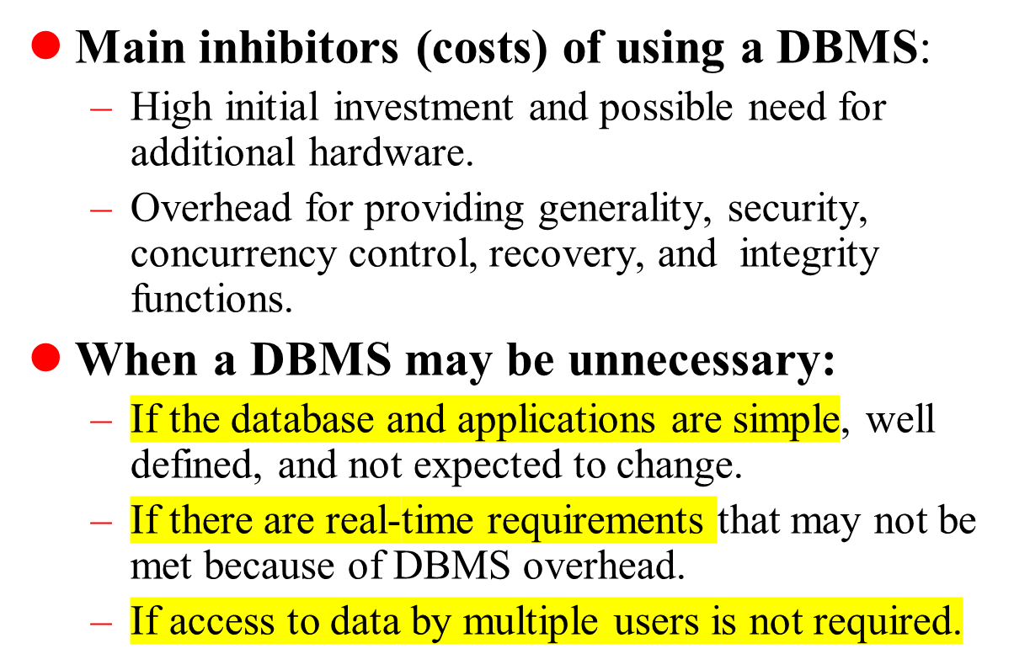

When not to use a DBMS

